Slide 1

The Nobel Project
Nobel Prize Winners 1901-2016

Slide 2
History of Nobel Prize/Introduction
Alfred Nobel’s Last Will
“Alfred Bernhard Nobel was a Swedish chemist, engineer, inventor, businessman, and philanthropist.” - Wikipedia
The Nobel Organization
The Nobel Organization was founded in June 1900 to manage the finances and the awards given for great achievements in Physics, Chemistry, Physiology or Medicine, Literature and Peace. The Nobel prizes were established.

Slide 3
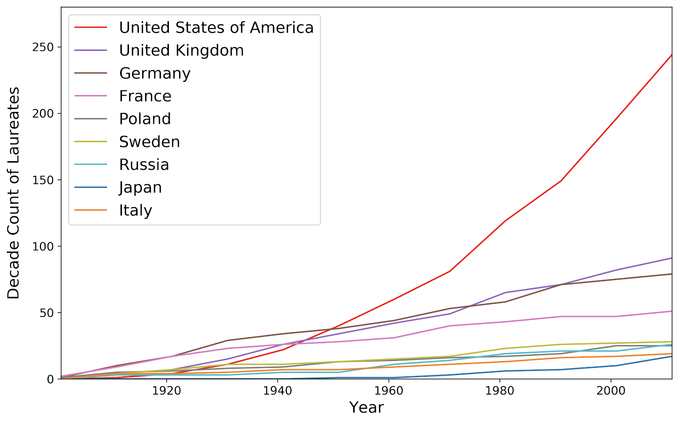
Group Hypothesis: America is the greatest country in the World.
Why is America the leading Country YOY?
Why is the Nobel prize so highly rated within the globe?
- It encompasses all major sciences

Slide 4

Data Retrieval & Cleanup
How did we obtain our data? We found our dataset on Kaggle.com which can also be found on the official Nobel Prize site. Additionally, the GDP data was retrieved from the World Bank API.
How did we clean our data? We created data frames to view the full data then eliminated any data that doesn’t apply to our research. Each member has a different data frame that is modified specifically for their hypothesis.

Slide 5
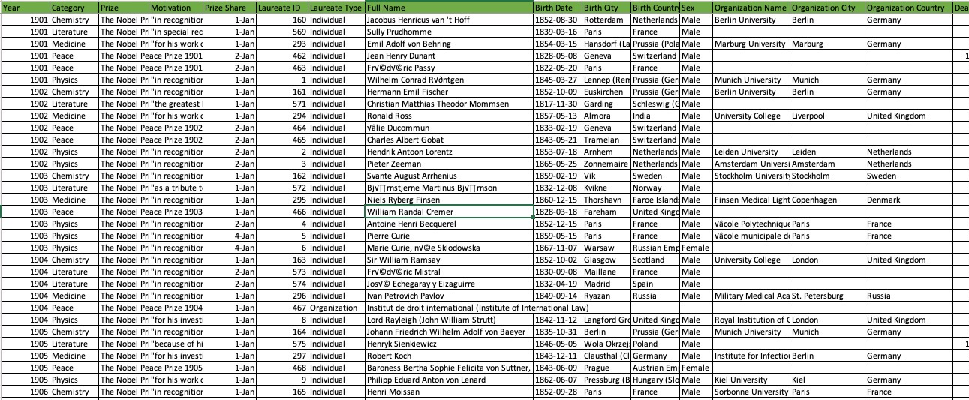
Raw Data

Slide 6
Team Individual Hypothesis

Slide 7
Hypothesis - Mitch
Winner is more likely to die in a different city than birth city, because of rough circumstances as a child.
Assumption: People who live extraordinary lives, come from extraordinarily tough backgrounds. The country of origin would influence this. So they would move to another country to flee bad circumstances.
Visible Factors in Data: Birth, Death and Organization Country.

Slide 8
Data Pitfalls and Solutions
Within the data, most of the people who received a Nobel prize have not died. Therefore, we do not have a full and complete data set to reflect what we are looking for.
By changing the parameters to Organization Country, we can get closer our assumption.

Slide 9
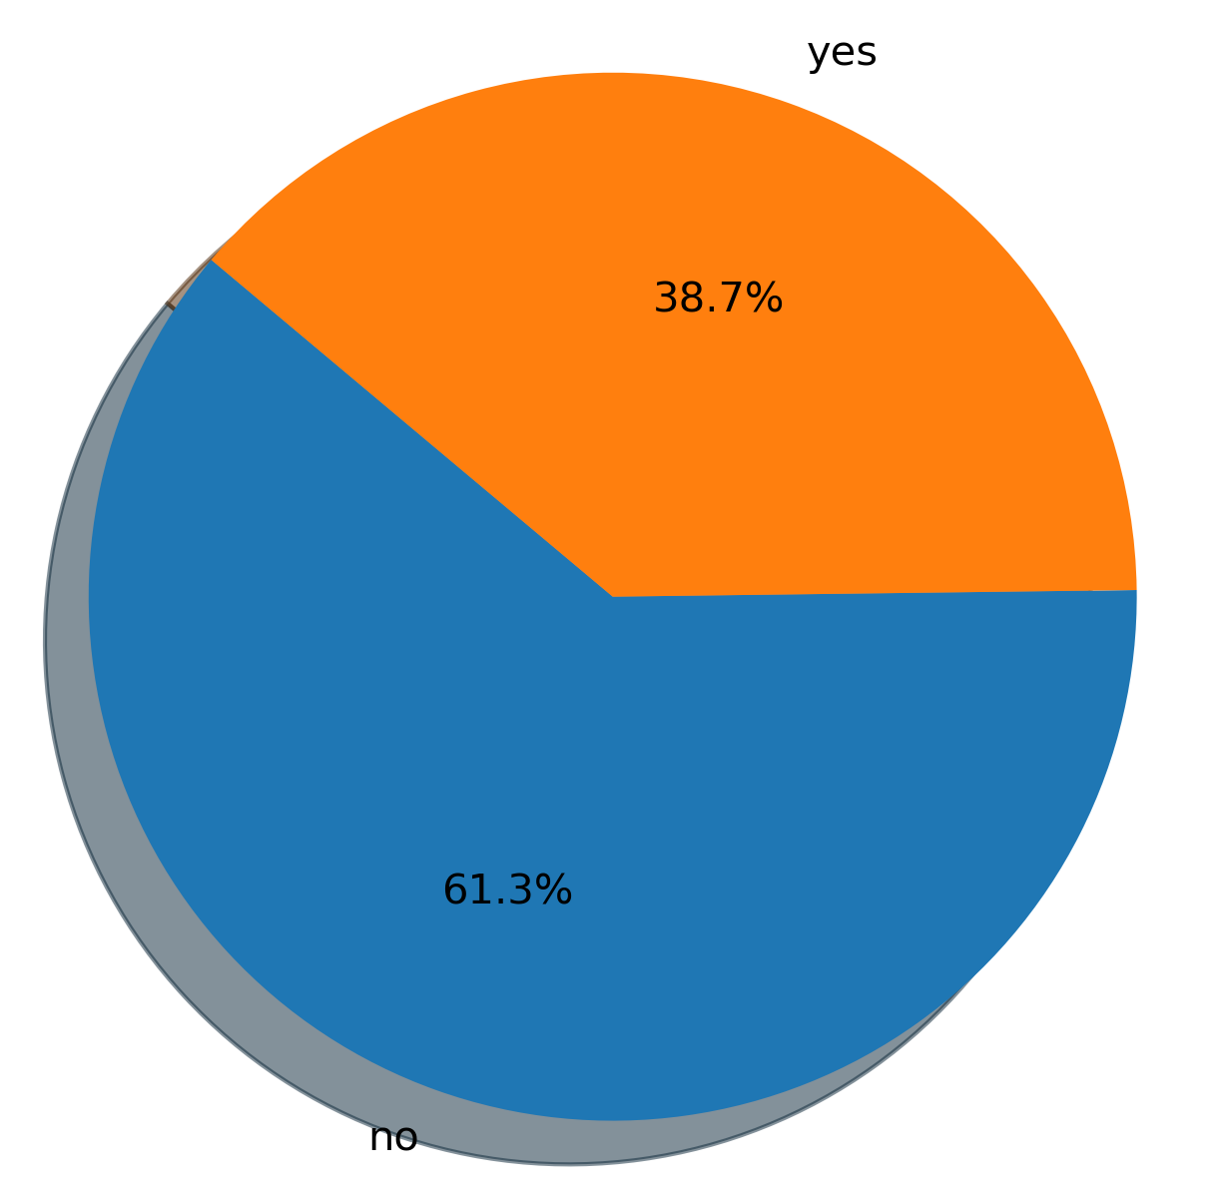
Winners Who Moved vs. Didn’t Move From Birth
Hypothesis was that most winners would be moving. In fact this was the opposite. There could be a number of different reasons why.
My hypothesis was wrong from the beginning.
The inverse is true, where if you grew up in a rough area, you wouldn't want to move away.

Slide 10
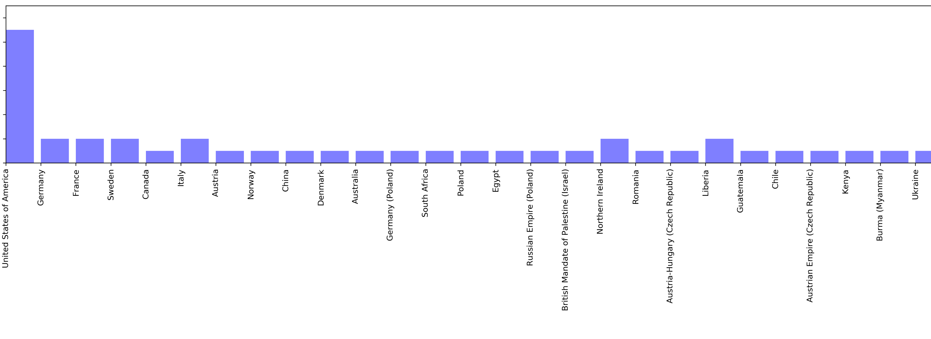
Hypothesis: Maanasa
Hypothesis: Majority of female Nobel prize winners are from the United States.
Assumption: Females in the United States have/had more freedom compared to other countries especially in earlier times allowing them to have the ability to work in various fields.
Visible Factors in Data: Birth City, Gender

Slide 11
Conclusion
People who are extraordinary, could be subject to rough circumstances, but this is not the only reason why they succeed.
New hypothesis: The more open doors/opportunities, the greater the capacity to succeed, known as “The Adjacent Possible”. - Referenced in “Where Good Ideas Come From” by Steven Johnson
This compounds over time and you get network effects building on each other.

Slide 12
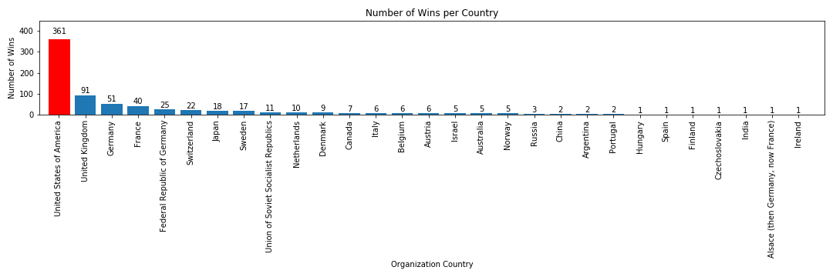
Organization Wins per Country
The United States based organizations won more Nobel Prizes than the rest of the world

Slide 13
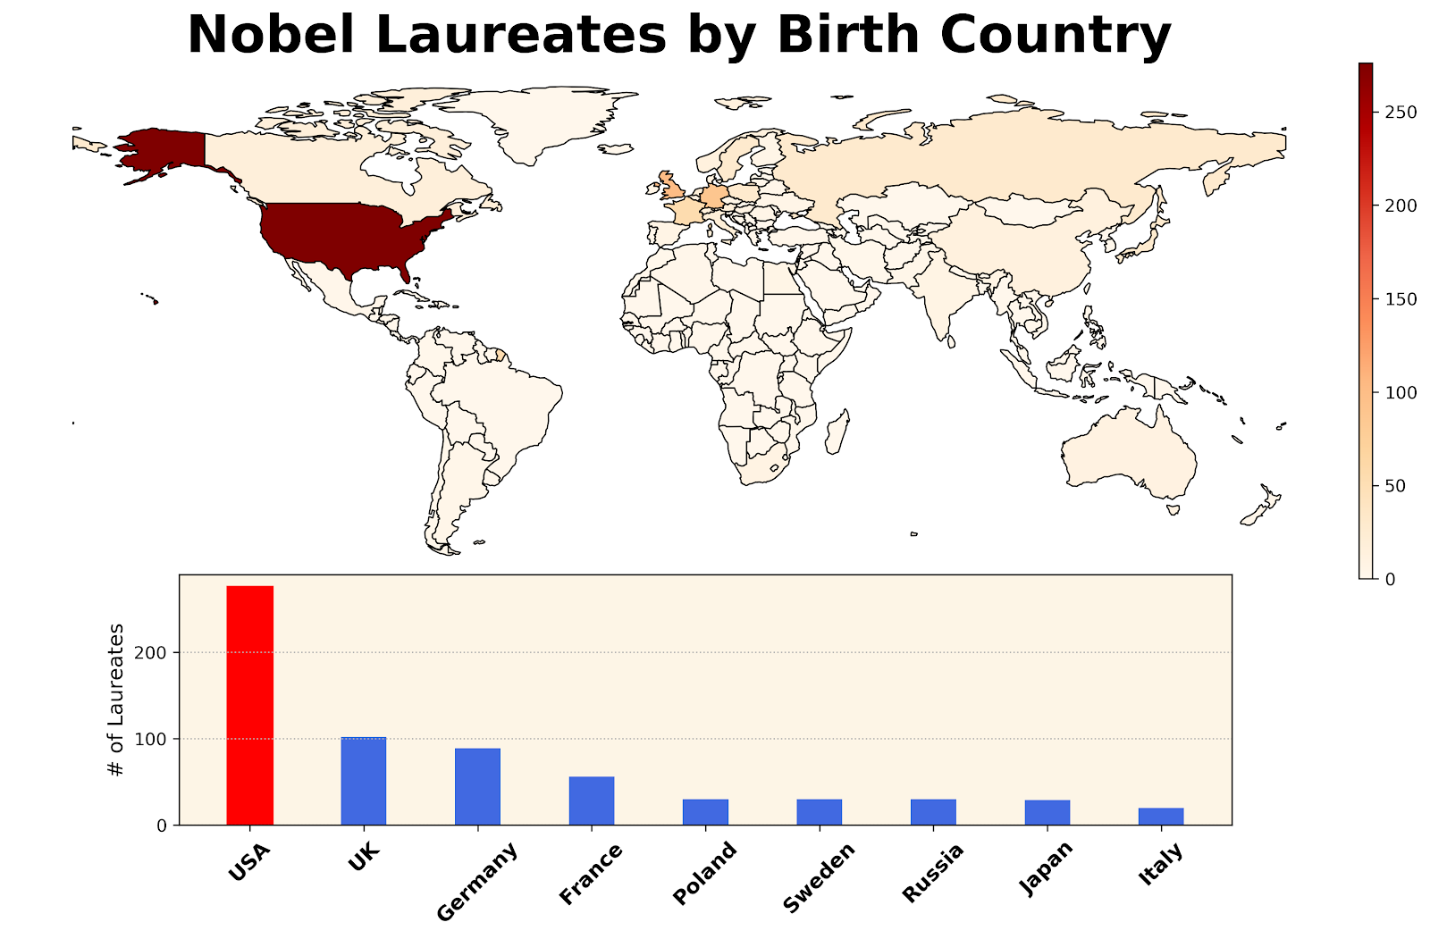
Influence of Nobel Laureates to Economy

Slide 14
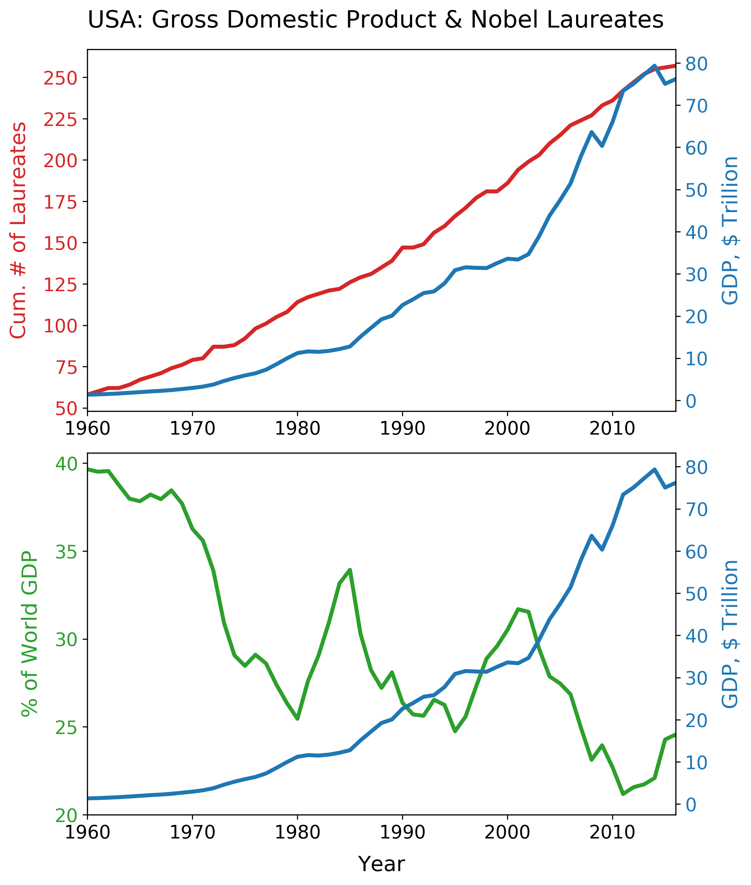
US GDP vs. Nobel Laureates
Gross Domestic Product
Economic health indicator
US laureates and GDP are increasing overtime
Does it mean more presence of Nobel laureate in US drives the US economy?
The % of US GDP to World GDP
A decline trend since 1960
Two build-ups in 1980s and 1990s.
Is there an increase in Nobel laureates in these bullish periods?

Slide 15
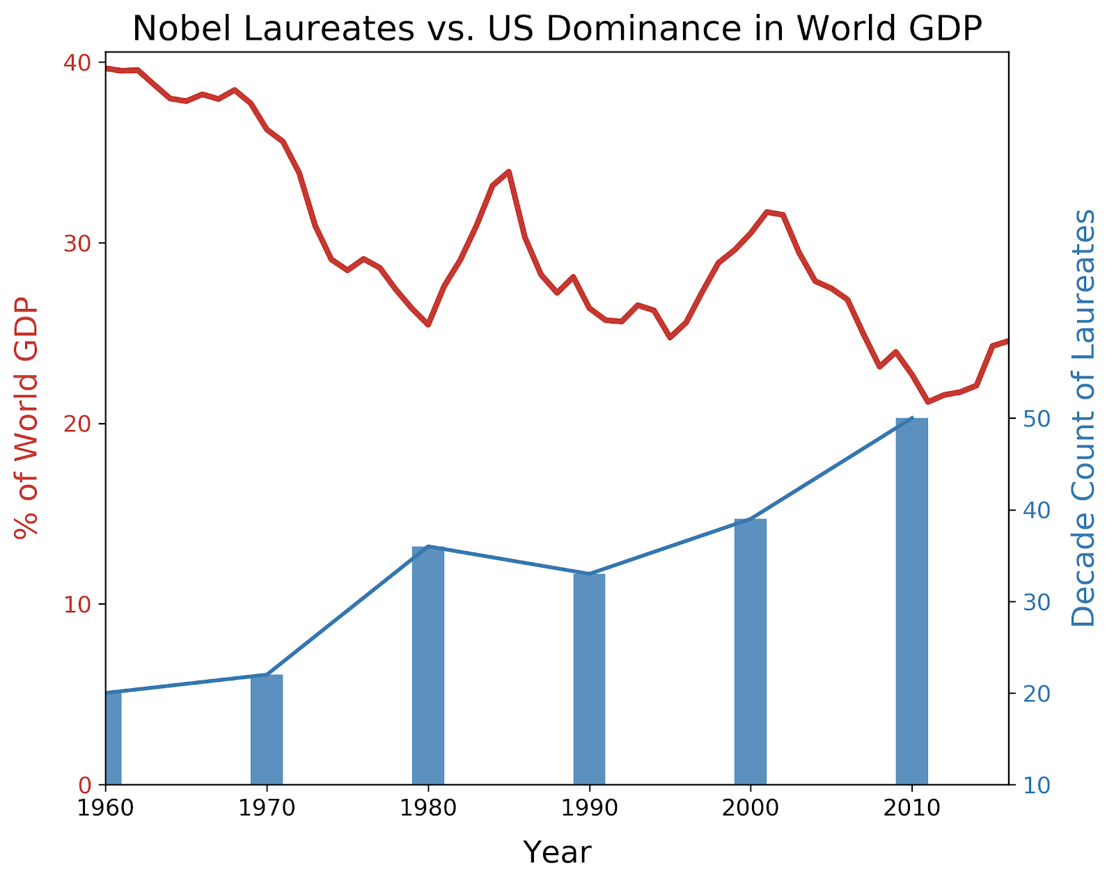
Does More Nobel Laureates Matter?
Yes!
1960-1980 seems prepared the economic growth
But the questions remain that
Did the economic boom enable the increase of laureate after 2000s?
Does the continuous increase of US laureates prepare the US to be a strong economic driver to the world in the next decade?
Conclusion
Data suggests the flourishing of academia happened prior to the economic boom, so the increase of Nobel laureates shows in the relationship.
However, it is unclear if the recent increase of laureates will assist or guarantee another boom in the future.

Slide 16
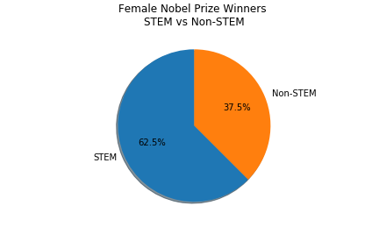
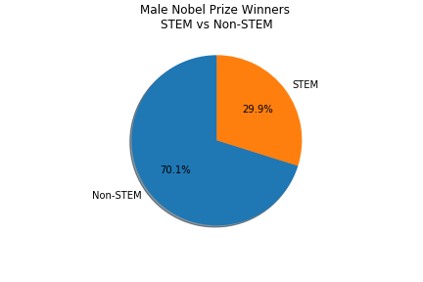
STEM vs. Non-STEM Prizes
Hypothesis –
Patrick
Assumption: The percentage of STEM related prizes versus non-STEM prizes by gender should reflect a higher percentage of STEM prizes for males.
Conclusion: The assumption was wrong, females received a higher percentage by gender of STEM related prizes.

Slide 17
Hypothesis- Shilpa
Gender Analysis of winners and the category they won in over the years (1901 - 2016) and specifically during World War II
Assumption - More female winners during World War II ( 1939 -1945 ) than their Male counterparts
Visible Factors in Data - Year, Gender, Category

Slide 18
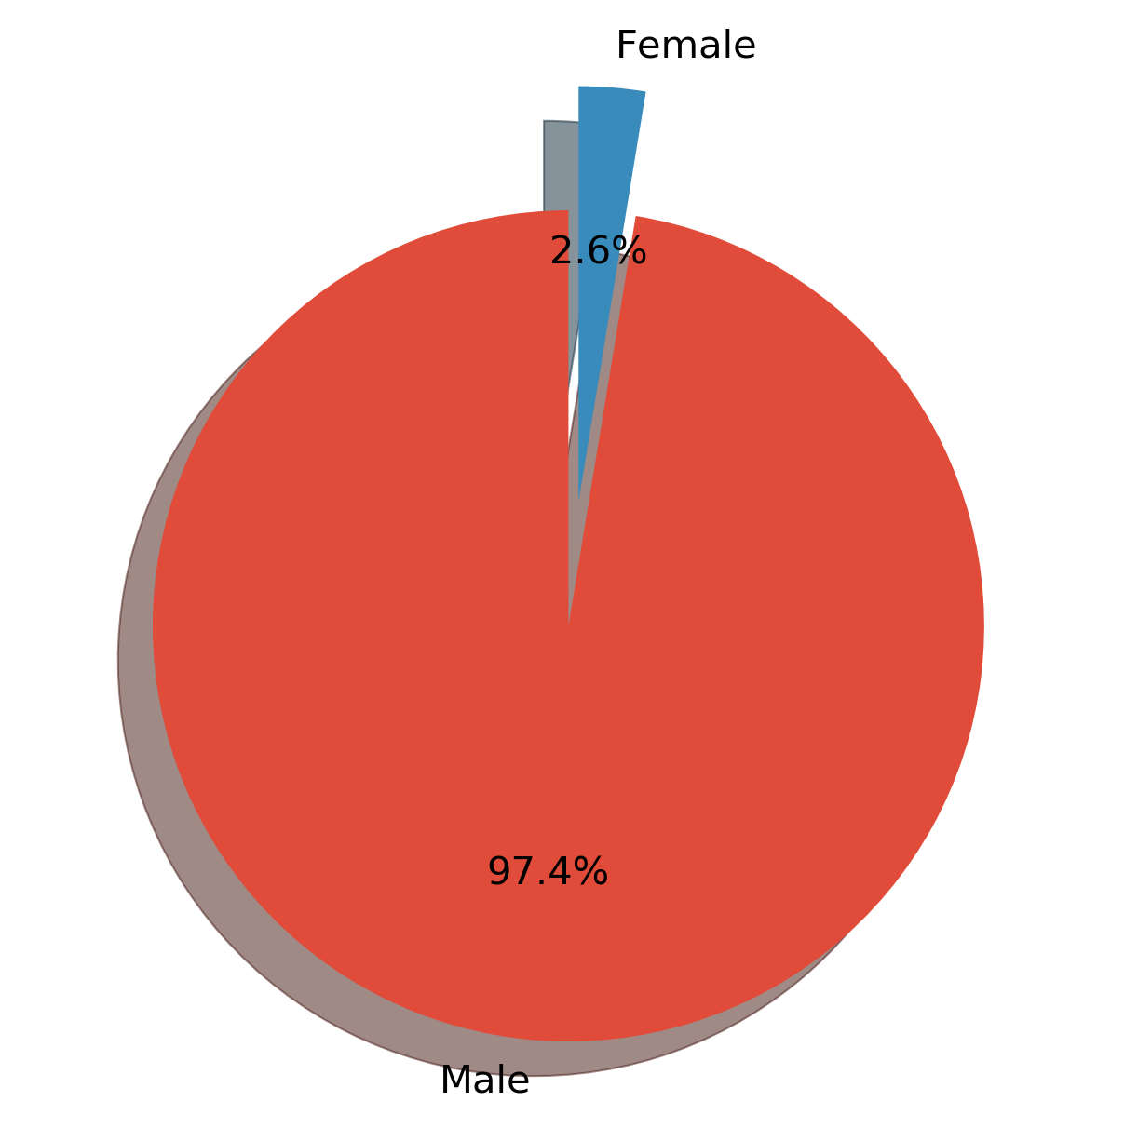
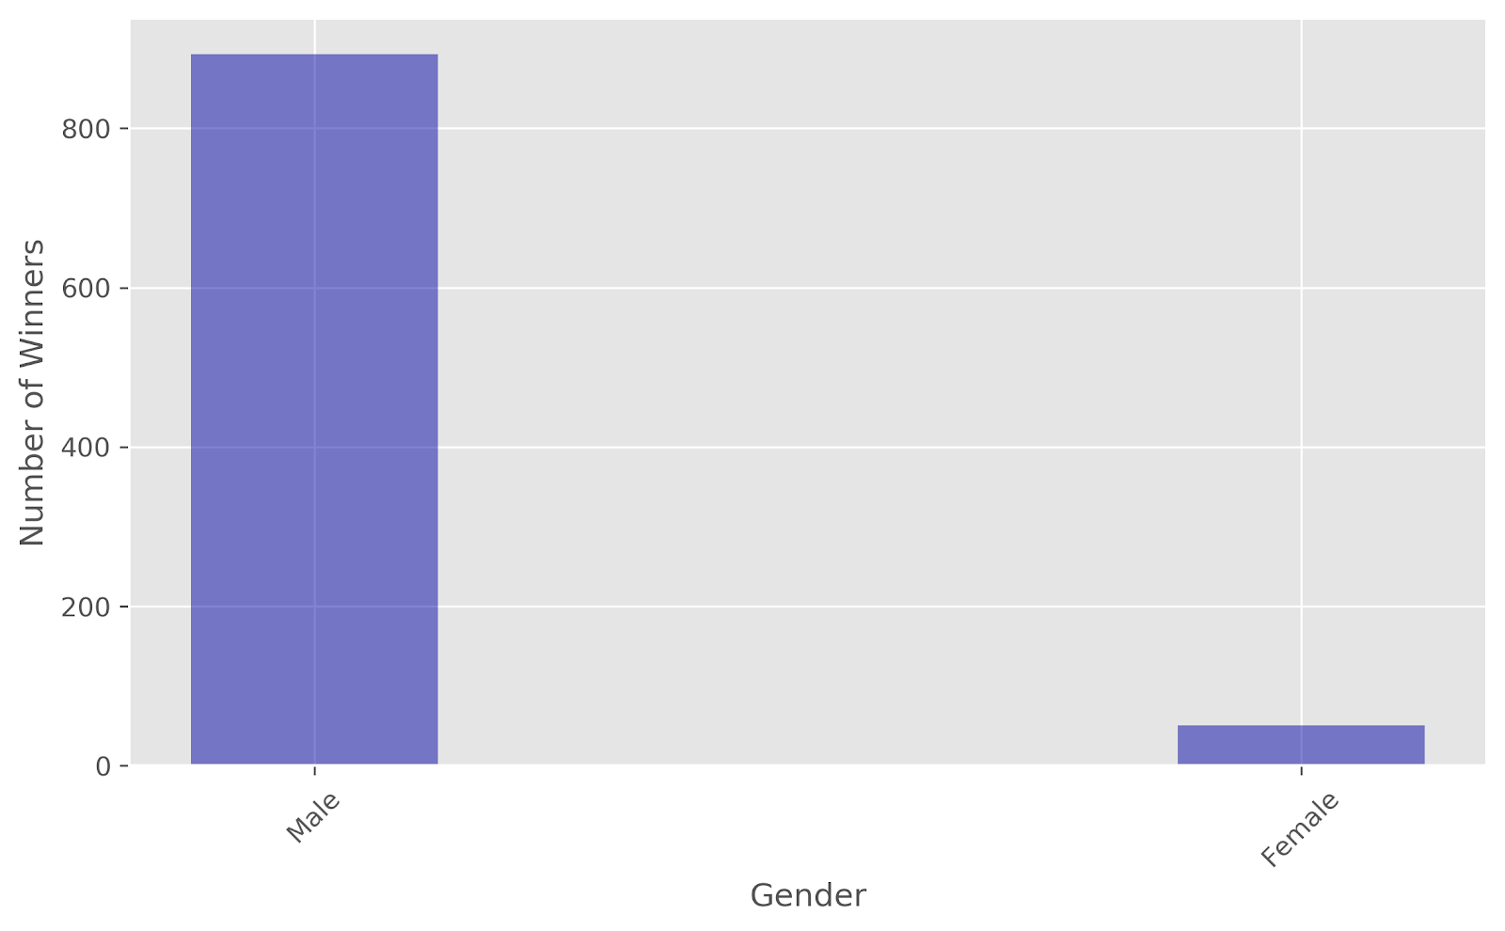
Gender That Won The Most

Slide 19
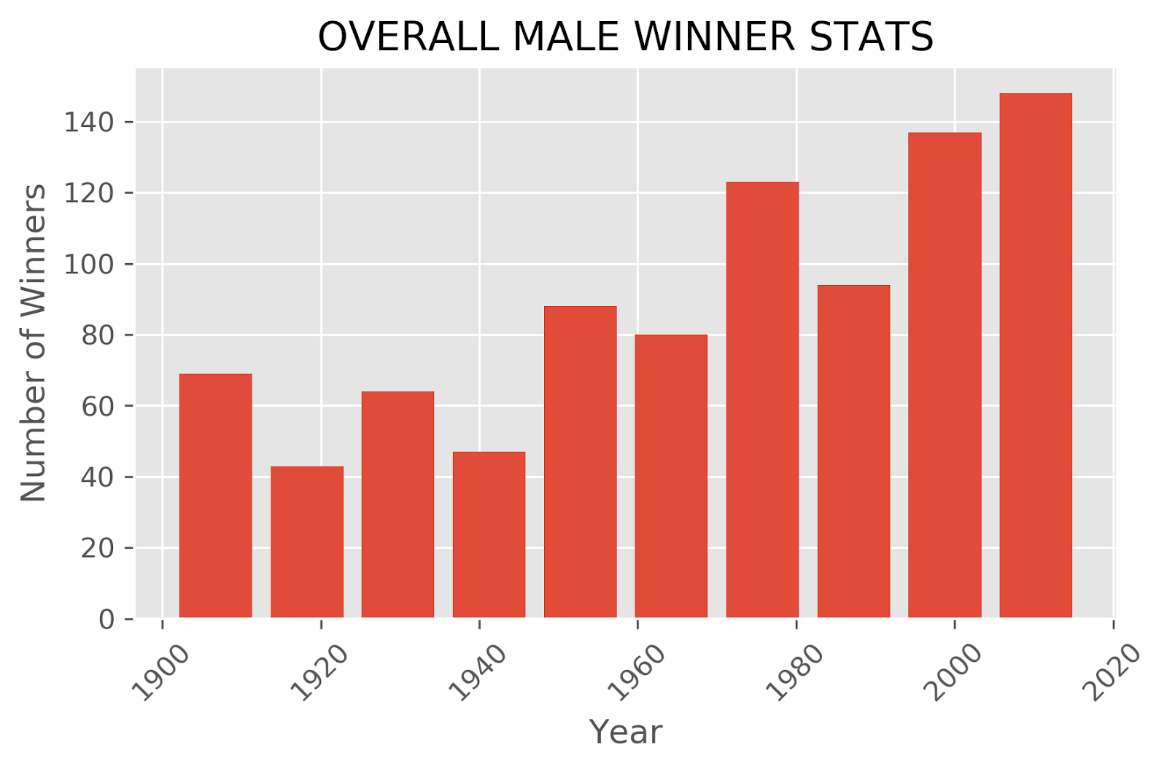
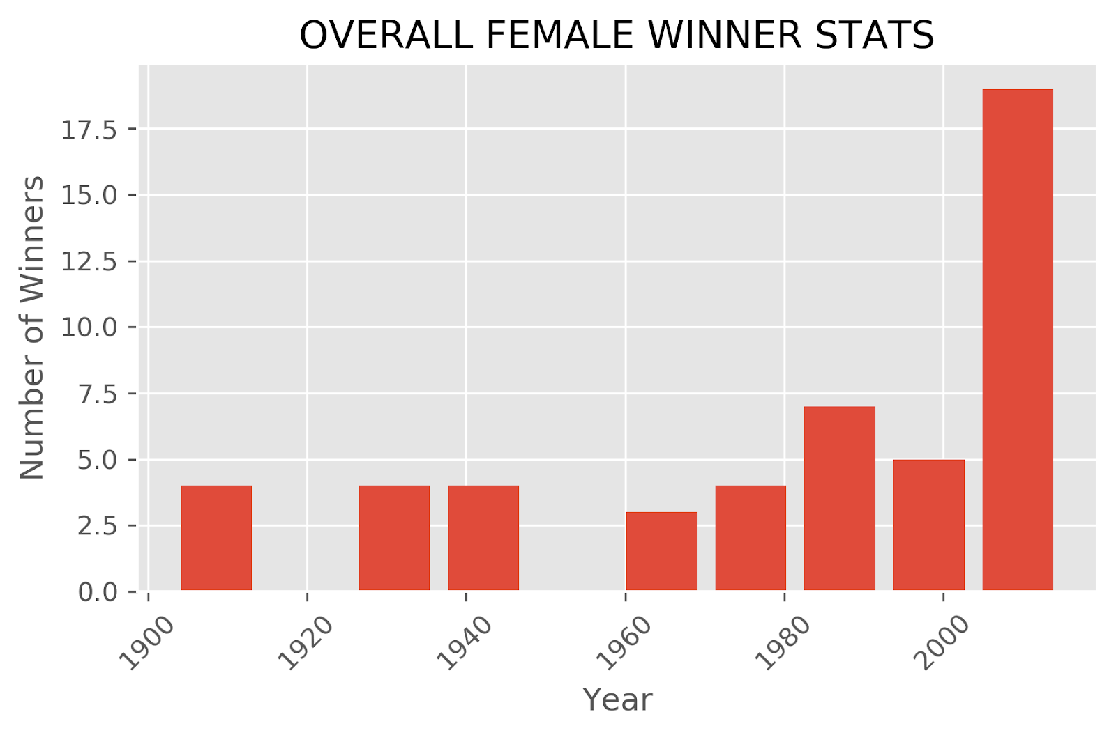
Winners Over the Years

Slide 20
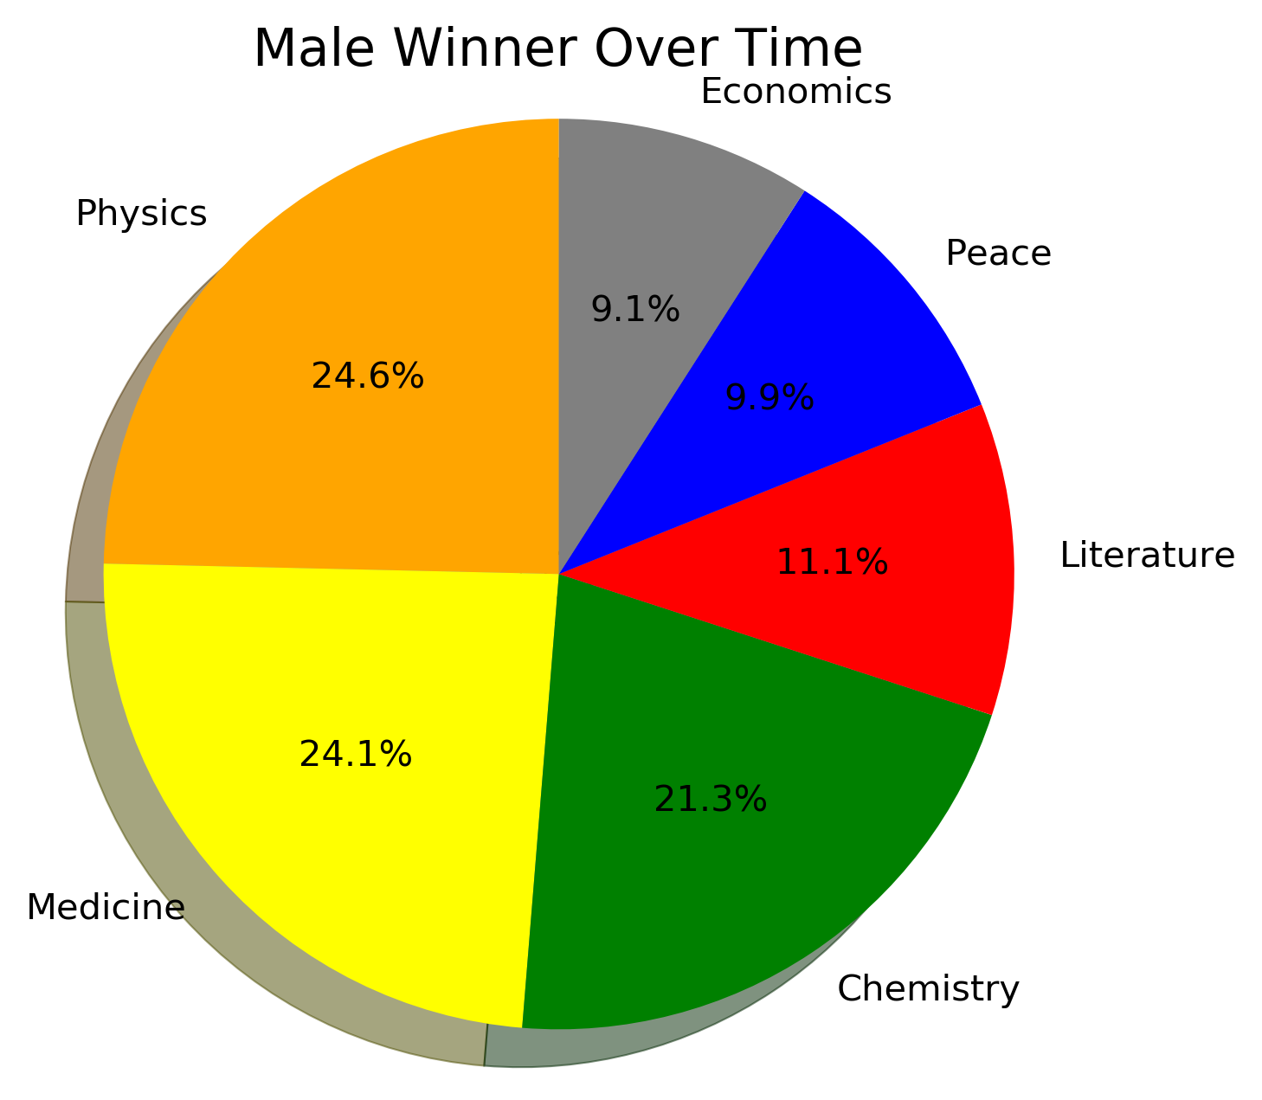
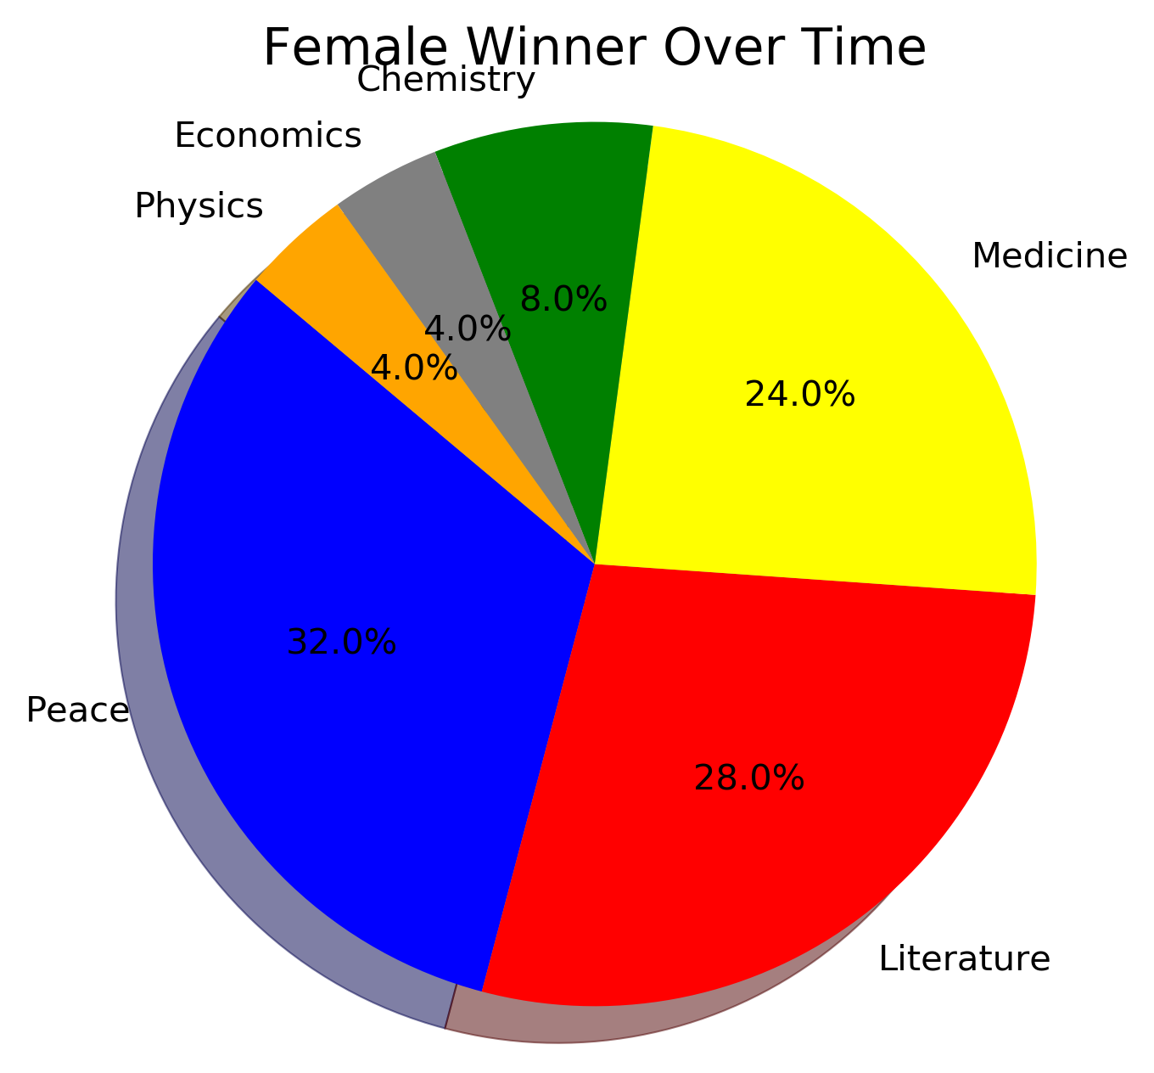
Categories Won Over the Years

Slide 21
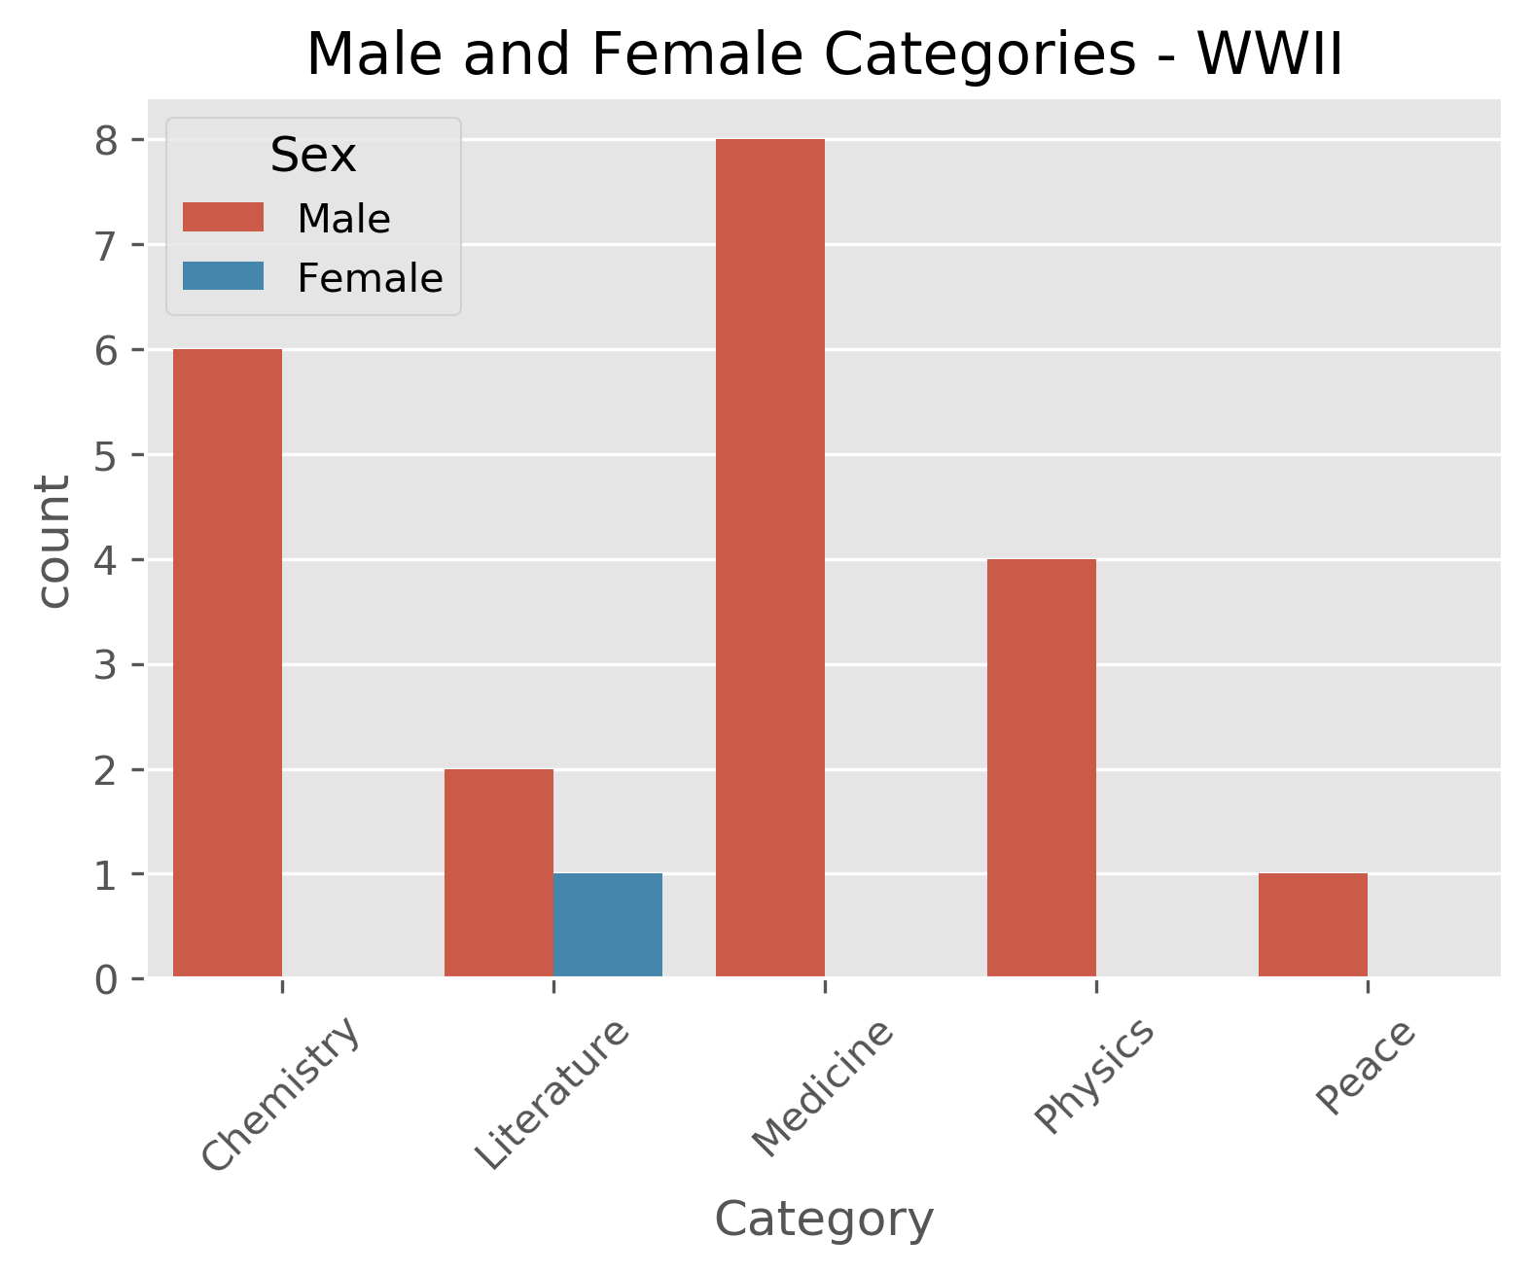
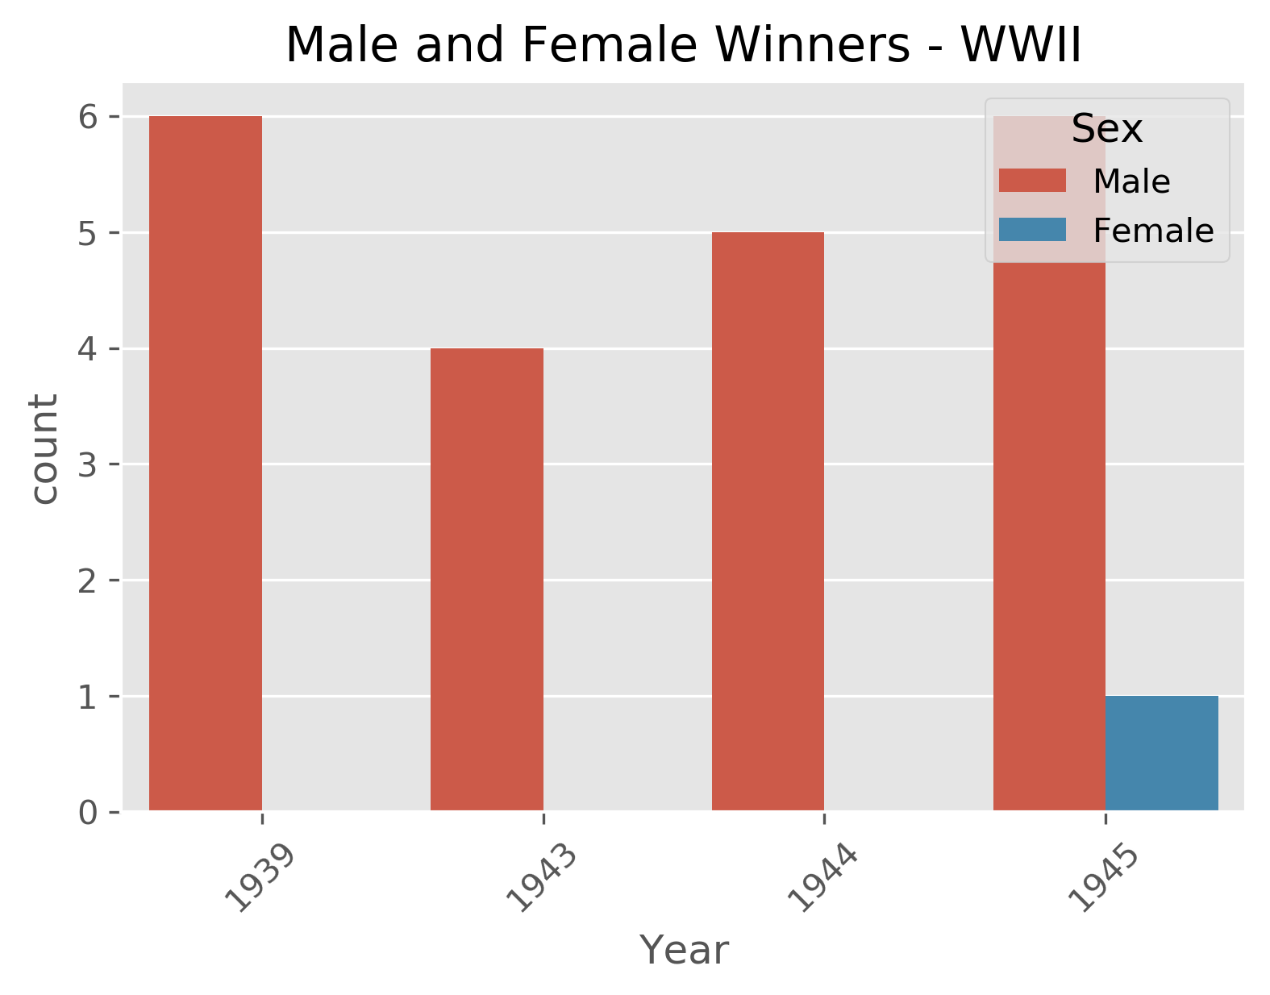
Comparative Gender Analysis During WW II

Slide 22
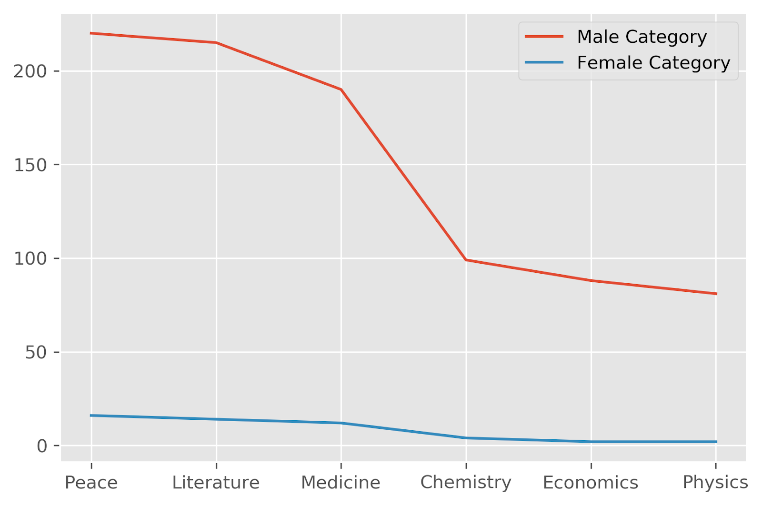
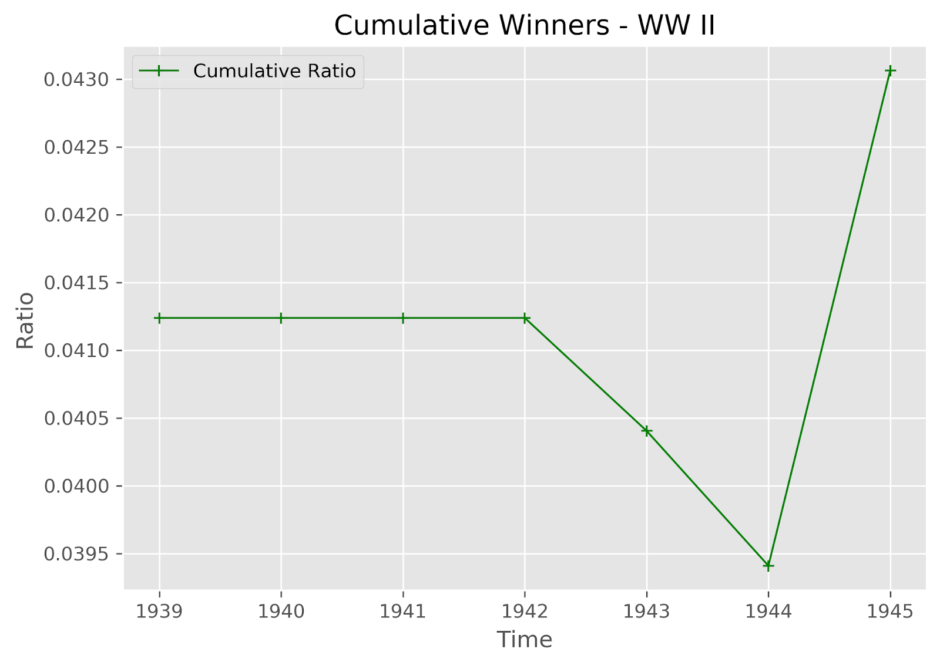
Trend Analysis

Slide 23
More Female Winners during WW II ?
Assumption - More female winners during World War II ( 1939 -1945 ) than their Male counterparts.
Conclusion - Data suggests otherwise . There are more number of males that have won the awards.
However, it would be interesting to know if this number would change in the future in that we would have more female Nobel Prize winners.

Slide 24
Summary of Overall Hypothesis
Given the data between countries, the United States has produced the most Nobel prizes by far compared to any other country.

Slide 25
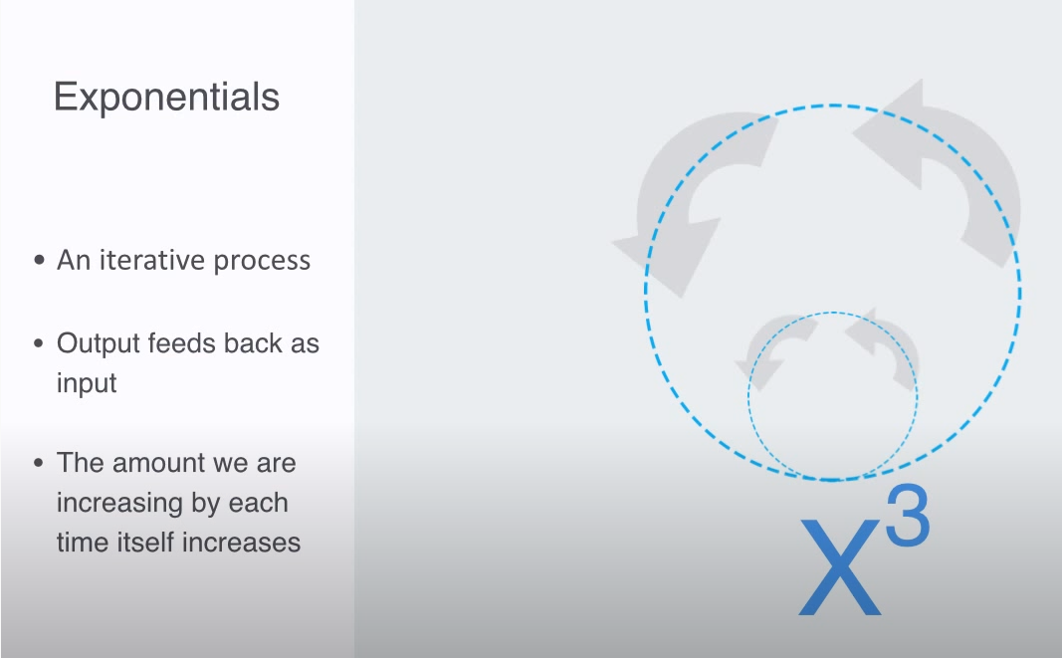
Exponentials and Power Laws

Slide 26
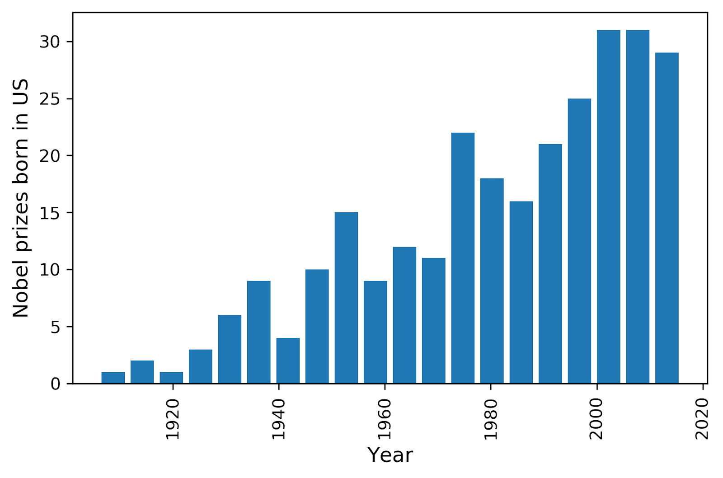
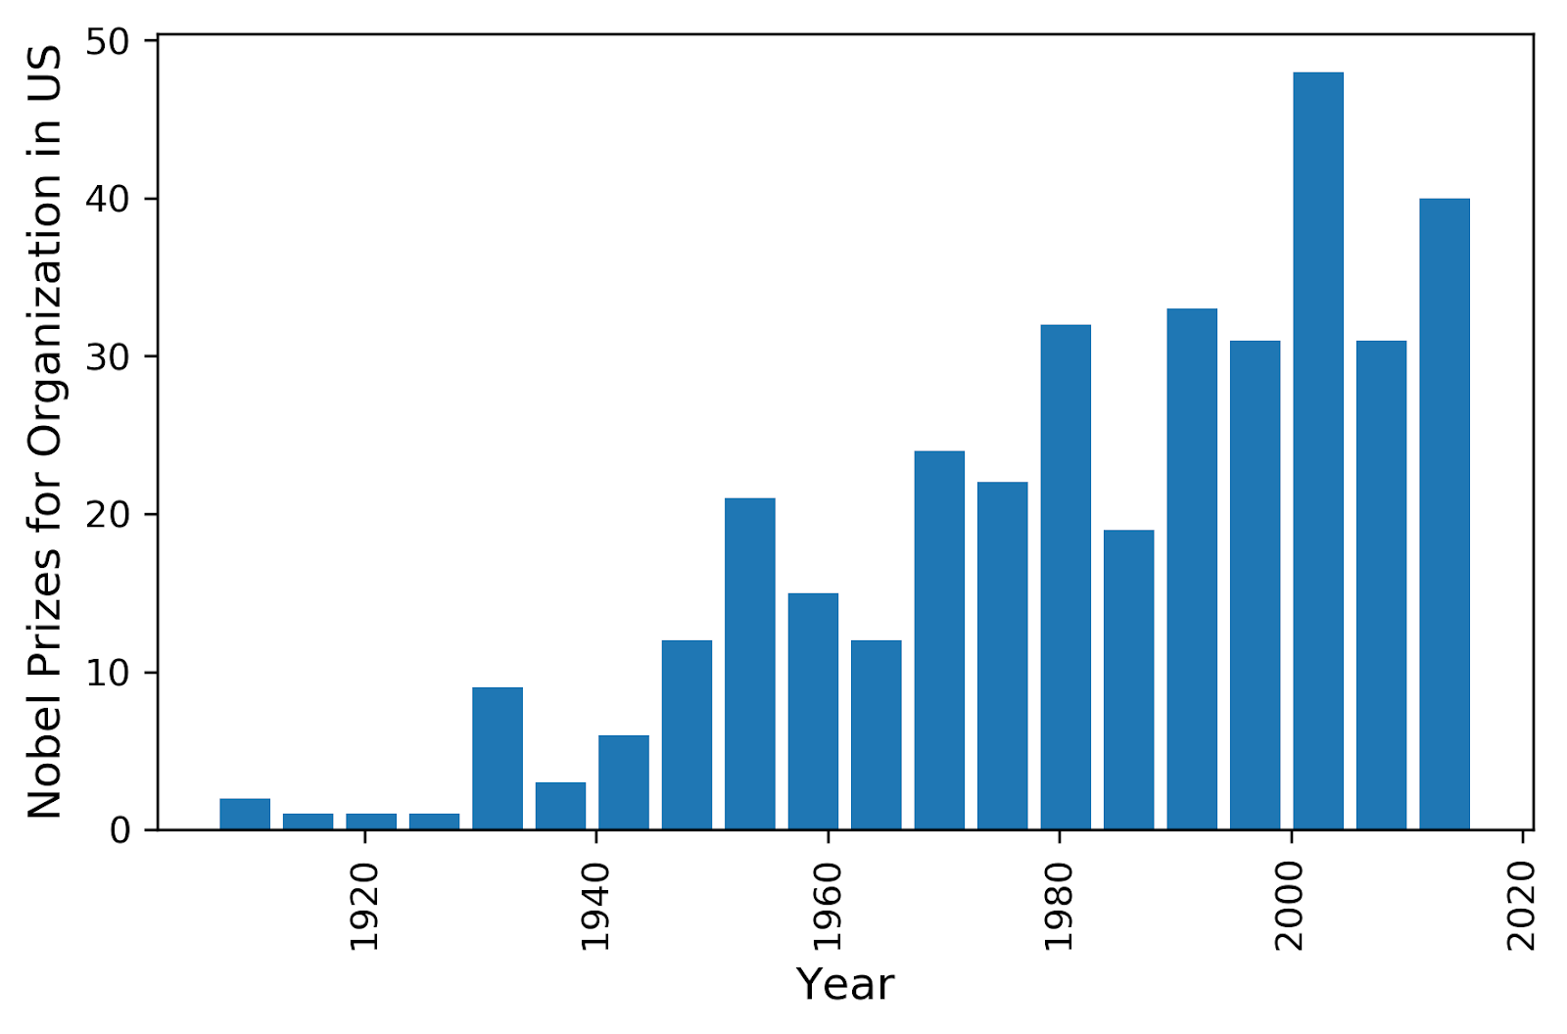
Compounding and Power Laws
As we create more innovations, they build off each other. People start gravitating towards great/progressive countries, and innovation compounds over time.

